Slide 1

Codex
A German beverage company
Delivering Key Insights to Empower the Marketing Team's Penetration into the Indian Market.

Slide 2
Other sources provided
About the project
A few months ago, the company CodeX launched their energy drink in 10 cities in India.
Their Marketing team is responsible for increasing brand awareness, market share, and product development.
They conducted a survey in those 10 cities and received results from 10K respondents.
As the data analyst, my responsibility is to transform these survey results into actionable insights that the team can utilize to drive effective actions.
Tools Used
MySQL
Power Point
Dataset required to generate insights
Metadata
Survey questions

Slide 3
Categories
Demographic Insights
Consumer Preferences
Competition analysis
Marketing channels
Brand Awareness
Brand Penetration
Purchase Behaviour
Product Development

Slide 4
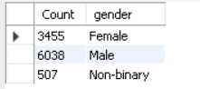
Demographic Insights
Who prefers energy drinks more?
SELECT COUNT(*) as Count ,
r.gender
FROM
fact_survey_responses as f
inner join
dim_repondents as r
on r.Respondent_ID = f.Respondent_ID
group by r.Gender;
Among different genders, males have a higher
preference for energy drinks, representing the maximum of the
total preference.

Slide 5
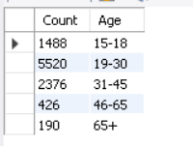
Demographic Insights
Which age group prefers energy drinks more?
SELECT COUNT(*) as Count ,
r.Age
FROM fact_survey_responses as f
inner join
dim_repondents as r
on r.Respondent_ID = f.Respondent_ID
group by r.age;
Age group 19-30 prefers more among other
age group peoples (5.5K).
The company has the opportunity to target the 19-30
age group as their primary audience, which can greatly
contribute to increasing sales

Slide 6
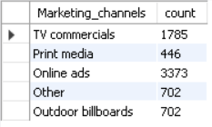
Demographic Insights
Which type of marketing reaches the most youth (15-30)?
select Marketing_channels,
count(Marketing_channels) as count
from dim_repondents r
join
fact_survey_responses s
using(Respondent_ID)
where age in ("15-18", "19-30")
group by Marketing_channels
The company has a significant opportunity to capture the
The attention of all by increasing the frequency of their
commercial advertisements on television channels especially when
introducing new offers.

Slide 7
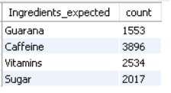
Consumer Preferences
What are the preferred ingredients of energy drinks among respondents?
select Ingredients_expected ,
count(*) as count
from
fact_survey_responses
group by Ingredients_expected
The company has a unique opportunity to target health-conscious
individuals by introducing a variety of natural flavours infused with
different vitamins

Slide 8
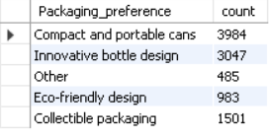
Consumer Preferences
What packaging preferences do respondents have for energy drinks?
select Packaging_preference ,
count(*) as count
from fact_survey_responses
group by Packaging_preference
The compact and portable cans were preferred by the maximum number of respondents (4K).

Slide 9
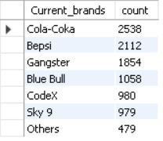
Competition Analysis:
Who are the current market leaders?
select
Current_brands ,
count(*) as count
from
fact_survey_responses
group by Current_brands
order by count desc
The company cola-coka leading in the Indian market.
Company CodeX and Sky 9 hold the same rank in the Indian
market, positioning them as direct competitors.
In order to outperform Sky 9, CodeX can use its strengths and
gain an advantage by introducing new and innovative
features.

Slide 10
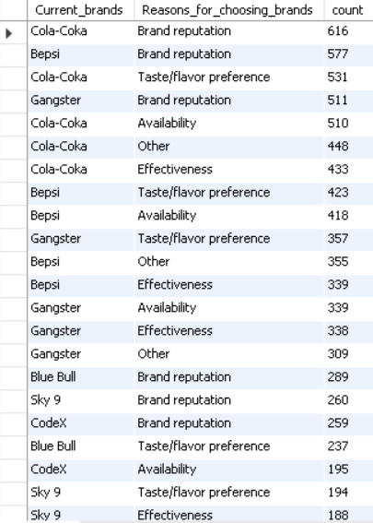
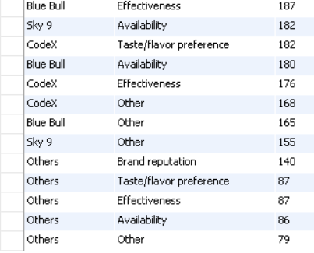
Competition Analysis:
What are the primary reasons consumers prefer those brands over ours?
select
Current_brands,
Reasons_for_choosing_brands ,
count(*) as count
from fact_survey_responses
group by Current_brands, Reasons_for_choosing_brands
order by count desc
To establish a strong brand reputation, we can advertise our brand through
popular marketing channels such as online ads and TV commercials.
This approach will help us reach a wider audience and build a positive
perception of our brand

Slide 11
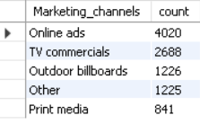
Marketing Channels and Brand Awareness:
Which marketing channel can be used to reach more customers?
select
Marketing_channels,
count(Marketing_channels) as count
from dim_repondents r
join
fact_survey_responses s
using(Respondent_ID)
group by Marketing_channels
order by count desc
Marketing channels play a crucial role across the industry. According to the survey responses, we have
discovered that online ads and TV commercials are the most effective means of reaching our target audience and
promoting our products directly to end users.

Slide 12
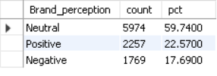
Brand Penetration:
What do people think about our brand? (overall rating)
select
Brand_perception ,
count(*) as count ,
(count(*)) / sum(count(Brand_perception)) over() *100 as pct
from fact_survey_responses
group by Brand_perception
The company CodeX has received an overall rating of Neutral from all the respondents, indicating a positive
sign for their marketing efforts in reaching the Indian market.
This rating reflects their hard work and successful engagement
with the target audience.

Slide 13
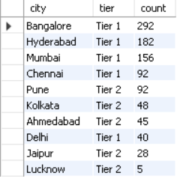
Brand Penetration:
Which cities do we need to focus more on?
select
city,
tier,
count(f.Respondent_ID) as count
from fact_survey_responses f join
dim_repondents r
on f.Respondent_ID = r.Respondent_ID
join
dim_cities c
on c.city_id = r.City_ID
where f.Current_brands = 'codeX'
group by City,tier
Order by count desc
Based on the analysis, Chennai and Delhi have the lowest consumption rate among all the Tier 1 cities.
Bangalore holds first place in energy drink consumption rate and Lucknow holds last place.

Slide 14
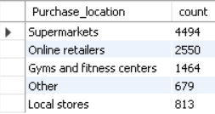
Purchase Behavior:
Where do respondents prefer to purchase energy drinks?
select
Purchase_location,
count(*) as count
from fact_survey_responses
group by Purchase_location
The company must ensure the continuous availability of energy
drinks in supermarkets at all times.
According to the responders, Supermarkets are the preferred option for purchasing energy drinks among all other options.

Slide 15
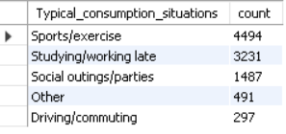
Purchase Behavior:
What are the typical consumption situations for energy drinks among respondents?
select
Typical_consumption_situations ,
count(*) as count
from fact_survey_responses
group by Typical_consumption_situations
Order by count desc
According to the survey conducted, specifically maximum of responders
preferring to drink during sports/exercise and studying/working late

Slide 16
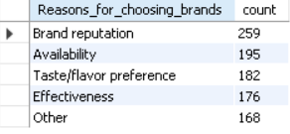
Product Development:
Which area of business should we focus more on our product development? (Branding/taste/availability)
select
Reasons_for_choosing_brands ,
count(*) as count
from fact_survey_responses
where Current_brands = "CodeX"
group by Reasons_for_choosing_brands
order by count desc
We should focus more on branding in our product development, as "Brand reputation" is the most common reason for choosing brands, with a count of 259 and we should focus on availability and taste.

Slide 17
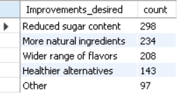
Product Development:
What immediate improvements can we bring to the product?
select
Improvements_desired,
count(*) as count
from
fact_survey_responses
where Current_brands = "CodeX“
group by Improvements_desired
order by count desc;
We observed that more individuals prefers to drink reduced sugar content, more natural ingredients and wide range of
flavours.
After analyzing the answers from respondents –improvements are desired, It’s possible that more people will be interested in our
product when we Introduce reduced sugar with a wide range of natural fruit flavors.

Slide 18
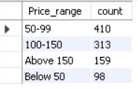
Product Development:
What should be the ideal price of our product?
select
Price_range,
count(*) as count
from fact_survey_responses
where Current_brands = "CodeX"
group by Price_range;
Based on the survey results, a maximum of the respondents showed a preference for purchasing products within the price range of 50-99,
Therefore, considering the ingredients used and the flavour of the
product, the company can consider setting an ideal price range of 90-120

